Slide 1
Introducing TAG: The Text Analytics Gateway

Slide 2
What is TAG?
A "gateway".
Technological service primarily for HASS researchers.

Slide 3
Humanities, Arts, and Social Sciences
University departments, libraries, labs, ...
No access to technical training.
Lack of institutional rewards.
Lots of text!

Slide 4
Computing in HASS
What they're used to
Programming
GUI/Web service.
Generally like local installs.
Interactive.
Not in their wheelhouse.
So why expect users to start with this?
corpus <- tm::tm_map(corpus, tm::content_transformer(base::tolower))
corpus <- tm::tm_map(corpus, tm::removePunctuation)
corpus <- tm::tm_map(corpus, tm::removeNumbers)
corpus <- tm::tm_map(corpus, tm::stripWhitespace)
corpus <- tm::tm_map(corpus, tm::removeWords, tm::stopwords("english"))
tdm <- tm::TermDocumentMatrix(corpus)
wordcount_table <- sort(rowSums(as.matrix(tdm)), decreasing=TRUE)
4

Slide 5
TAG: Text Analytics Gateway
The TAG Team
Timeline
PI Mike Black
Drew Schmidt
New ECSS Staff soon...
November 12, 2014: XSEDE Allocation awarded.
March 20, 2015: Developent begins.
July 7, 2015: Stood up on AWS, small usability studies begin.
Soon: Live on comet, workshops, ...

Slide 6
XSEDE
eXtreme Science and Engineering Discovery Environment
NSF cyberinfrastructure organization
"supercomputing"
Growing interest in data.

Slide 7
The TAG Philosophy
Easy to use.
Reproducibility should not be an afterthought.
Interactivity is good!
Community contributions, comments, suggestions should be encouraged.
We're not chasing exascale.

Slide 8
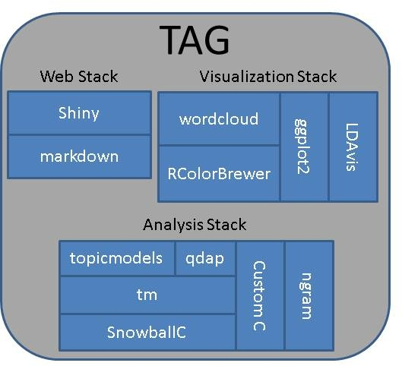
TAG Design
Written mostly in R.
Some custom high-performance C.
Extensively uses existing R packages.
UI served via shiny.
Help files written in Markdown.

Slide 9
TAG Installation
Easy to install and run locally.
Relatively easy to stand up in a vm.
Installation and updating:
R> devtools::install_github('XsedeScienceGateways/TAG')
Starting:
TAG::runTAG()
Deployment script for Ubuntu: https://raw.githubusercontent.com/XSEDEScienceGateways/TAG/master/inst/deploy.sh

Slide 10
Challenges and Future Work
Integration within XSEDE.
Add multidocument support.
Better I/O.
Add sentiment analysis.
Develop userbase and community.
Legal issues?
Sustainability.
Proper UI/UX.

Slide 11
Community Building
Encourage usage and contributions.
GitHub: https://github.com/XSEDEScienceGateways/TAG
Help written in Markdown.
Plans to include reporting system that doesn't require GitHub account.

Slide 12
Thanks
Questions?

